Slide 1

Smart agricultural system Ece5042 - MICROCONTROLLER ARCHITECTURE AND ORGANIzATION PROJECT
B roHITH 20mes0038
SHRUTI GHADGE 20MES0050
AJITH KUMAR R 20MES0052

Slide 2
OBJECTIVE
To Design a Smart Agriculture Product to automate irrigation, lighting and provide useful weather insights
To design a scalable and marketable embedded device
To learn the ARM architecture and how to develop products with it
To try the Embedded programming language Rust
To learn to use the HAL Libraries

Slide 3
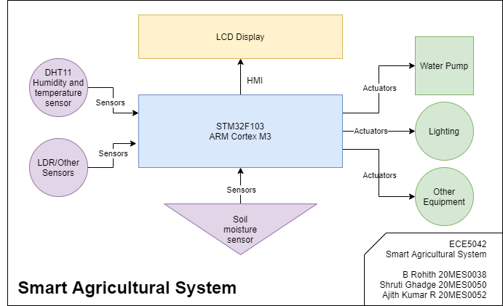
Block diagram

Slide 4
components
Hardware
Software
STM32F103C8^{[1]}, based on ARM Cortex-M3, commonly known as the blue pill
ST-LinkV2, SWD to USB adapter for Debugging
LCD Display to show status and offer a basic HMI
Capacitive Soil Moisture Sensor
DHT-11 Humidity and Temperature Sensor
A mini water pump for demo
A Bulb or LED for realising lighting control
Rust^{[2]} Toolchain for programming in Rust
ARM Toolchain for Cross-Compiling
OpenOCD^{[3]}/GDB^{[4]} for Breakpoint/Watchpoint Monitoring and Debugging
HAL Library Crates^{[5]} for STM32F103 specific Hardware Abstraction APIs

Slide 5
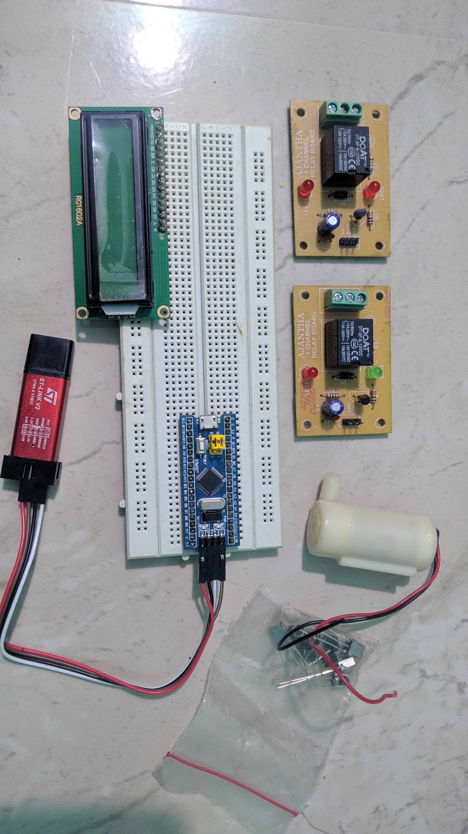

Slide 6
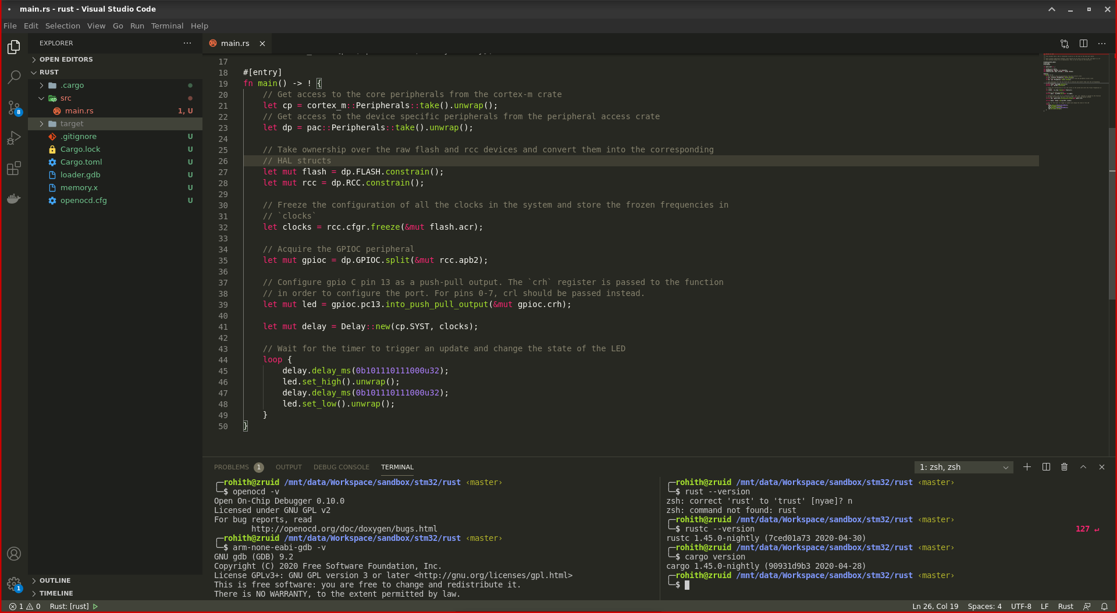

Slide 7
methodology
The controller logic will be programmed in Rust lang and flashed via Serial Port.
Open On-Chip-Debugger and GDB will be used to debug the code by monitoring watchpoints and breakpoints via software wire debugging SWD
A Soil Moisture Detector and DHT-11 will input analog value to the microcontroller.
Based on the values from the sensors, the water pump and Lighting will be controlled
An LCD will display the Status

Slide 8
references
[1] ST Microelectronics: STM32F103 devices use the Cortex-M3 core, with a maximum CPU speed of 72 MHz
[2] Rust: A language empowering everyone to build reliable and efficient software
[3] Open On-Chip Debugger: Free and Open On-Chip Debugging, In-System Programming and Boundary-Scan Testing
[4] GDB: The GNU Project Debugger
[5] GitHub: A curated list of Rust code and resources
[6] R. Ramya ; C. Sandhya ; R. Shwetha, Smart farming systems using sensors, 2017 IEEE Technological Innovations in ICT for Agriculture and Rural Development (TIAR), April 2017
[7] G. Arvind ; V. G. Athira ; H. Haripriya ; R. Akshaya Rani ; S. Aravind, Automated irrigation with advanced seed germination and pest control, 2017 IEEE Technological Innovations in ICT for Agriculture and Rural Development (TIAR), April 2017
[8] Chetan Dwarkani M ; Ganesh Ram R ; Jagannathan S ; R. Priyatharshini, Smart farming system using sensors for agricultural task automation, 2015 IEEE Technological Innovation in ICT for Agriculture and Rural Development (TIAR), July 2015

Slide 9

Thank You!

